Slide 1
Rapid ART Initiation and Index Client Testing Outcomes of CommLink, a Community-based, HIV Testing, Mobile HIV Care, and Peer-delivered Linkage Case Management Program – Eswatini (formerly Swaziland), 2017
Division of Global HIV & TB
D. Williams, D. MacKellar, M. Dlamini, N. Simelane, S. Mlambo, P. Mamba,
J. Byrd, S. Mazibuko, I. Pathmanathan, L. Dube, M. Pasipamire, V. Nxumalo,
L. Nomthandazo, A. Beyer, C. Ryan
Pedal to the metal: Accelerating the cascade
Thursday, 26 July 2018
AIDS 2018

Slide 2
CommLink Eswatini Context & Background

Slide 3
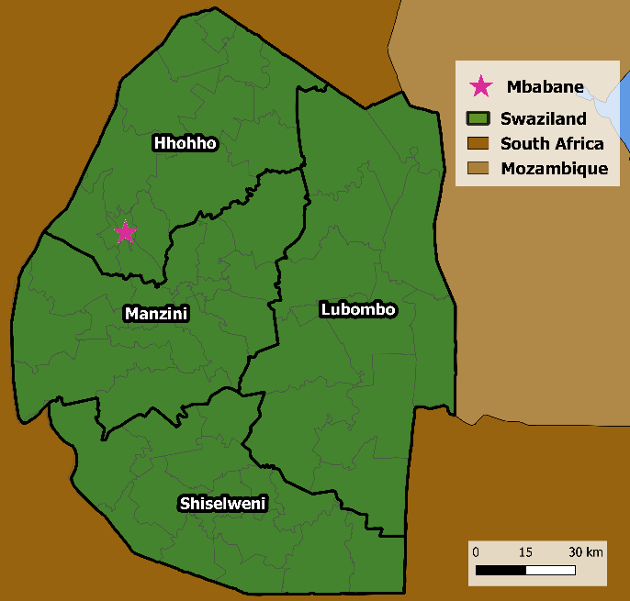
Eswatini Context
Population ~1.1 million
~200,000 people living with HIV (PLHIV) ≥15 years (2017)
High HIV prevalence and incidence
27% PLHIV ≥15 years
Annual HIV incidence at 1.4%
Low linkage to HIV care among PLHIV diagnosed in community settings
17%-34% (2 studies, n~1,500) enrolled within 6 months of diagnosis^{1,2}
Young adult PLHIV at much higher risk for delayed linkage to care^{1,2}
¹Parker et al. Tropical Med and Int Health, 2015
²MacKellar et al. PLoS One, 2016

Slide 4
Background
The CommLink Linkage Case Management (LCM) program was developed with the goal to link to care >90% of community-diagnosed PLHIV by providing the full package of services recommended by
International Association of Physicians in AIDS Care (IAPAC)
U.S. Centers for Disease Control and Prevention (CDC)
World Health Organization (WHO)
Informed by experiences and outcomes of the LCM program of the Bukoba Tanzania Combination Prevention Evaluation
Poster by O. Rwabiyago et al. – On display Thursday, 26 July, 10-18:30 (#THPEC288)

Slide 5
CommLink Client Services & Program Design

Slide 6
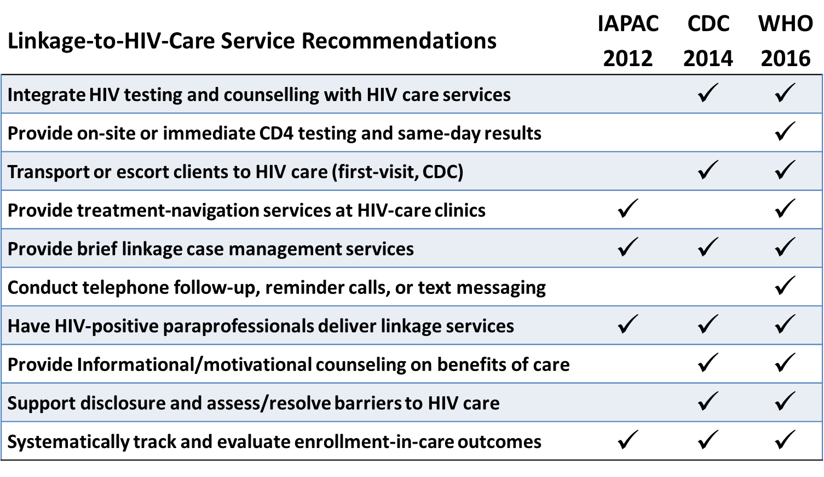
Recommended LCM Services

Slide 7
Implementation of Recommended LCM Services
CommLink Nurse
HIV+ Client
Expert Client Counselor (EC)
HIV Testing Services (HTS) outreach
Community-based events
Positive clients identified and introduced to an Expert Client Counselor (EC)
1st Session
Focused on encouraging early enrollment in HIV care
EC escorts the client to an on-site mobile unit to receive baseline HIV clinical services from a CommLink nurse.
Treatment Navigation
Orient the client to facility layout and personnel
EC stays with client the duration of
the visit
Same-day transport/escort if needed
Additional Session(s)
e.g. ICT, additional psychosocial
support and counseling, etc.
3rd Session
2nd Session
Provide psychosocial support
Discuss and attempt to resolve barriers to care
Encourage disclosure when and where appropriate
Provide index client testing (ICT) to partners and family members

Slide 8
CommLink Phases, Scale, & Operations
Notes:
A closer look at the operations of the program..

Slide 9
CommLink Phase I: June 2015 – March 2017
Partnership
Implemented by Population Services International (PSI) in collaboration with the Eswatini Ministry of Health & CDC
Scale
2 Mobile unit teams of 3 EC counselors and 1 nurse each
HTS provided by ~2-4 lay counselors per outreach
Operating Area
Select areas in Manzini and Hhohho Regions
Phase I Outcomes¹
651 participants
635 (98%) enrolled in facility-based HIV care
541 (83%) initiated ART
90 (66%) during CD4<350 period
234 (81%) during CD4<500 period
217 (96%) during Test & Start (began 1 Oct 2016)
Phase I Operating Areas
¹MacKellar et al. MMWR, 2018

Slide 10
CommLink Phase II: April 2017 – March 2018
Scale
4 Mobile unit teams of 3 EC counselors and 1 nurse
Operating Area
Manzini, Hhohho, & Lubombo Regions
Modified Methods
Expanded the scope of Index Client Testing (ICT) to include associates of clients
Associates are persons other than partners or family members who have defaulted from care or who might benefit from HTS
Examples include friends, neighbors, coworkers, etc.
Phase II Operating Areas

Slide 11
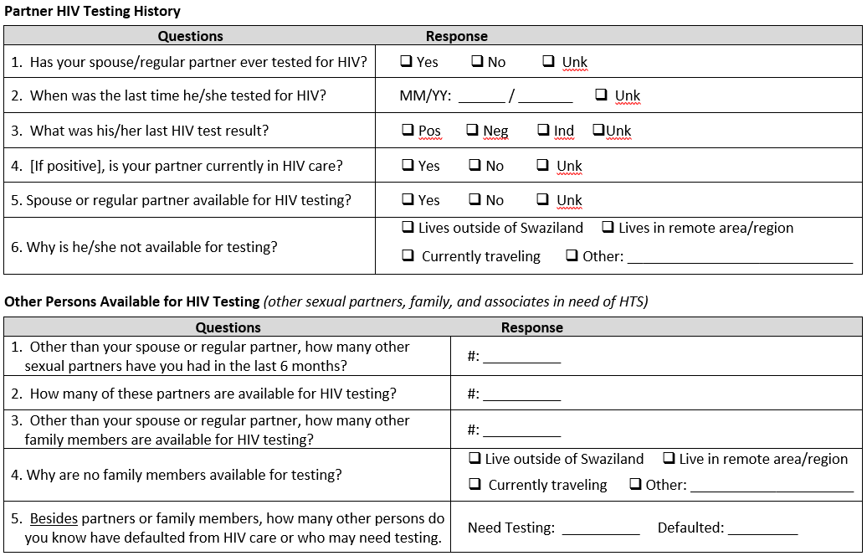
CommLink Phase II: April 2017 – March 2018
Spouse /
Regular Partner
Family
Associates

Slide 12
CommLink Phase II Outcomes: April 2017 – March 2018

Slide 13
CommLink Phase II Outcomes
709 HIV+ HTS Clients ≥ 15 Identified
6 Not Screened for eligibility
703 (99%) Screened for eligibility
107 Screened ineligible
596 (85%) Screened eligible
17 Refused participation
579 (97%) Participated in LCM
99 Cases open at time of analysis
480 (83%) Clients with data
available for analysis

Slide 14
CommLink Phase II Outcomes
Enrollment in Care, ART Initiation; and Partner, Family Member, and Associate (PFA) Testing Outcomes
*Received antiretroviral therapy within seven days of diagnosis
* * Among those initiated on ART

Slide 15
CommLink Phase II Outcomes
Partners, Family Members, and Associates (PFAs) Tested through CommLink
*Does not include clients previously diagnosed HIV-positive, currently in care (n=2); or clients with an unknown diagnosis (n=4)

Slide 16
CommLink Phase II Outcomes
Of 166 eligible PFAs identified through index client testing
165 (99%) participated in CommLink
28% of all 579 CommLink cases in Phase II were identified through ICT
Of 144 closed cases of PFAs identified through ICT:
138 (90%) enrolled in facility-based HIV care
Median days (IQR) from consent to enrollment = 2 (1-4)
138 (90%) were initiated on ART
Median days (IQR) from consent to ART initiation = 2 (1-4)

Slide 17
CommLink Limitations, Conclusions, & Next Steps

Slide 18
Limitations
Although high (>80%), CommLink consent rates are not perfect and enrollment in care outcomes are unknown among non-participants
Although most clients (>90%) return for at least one ARV refill, retention in ART care (e.g., at 6 and 12 months) is unknown
Start up costs for CommLink are high, driven largely by mobile units. Substitution of tents for mobile units reduces costs and may be just as effective.

Slide 19
Conclusions
Providing the package of recommended peer-delivered linkage case management (LCM) services achieved near-universal ART initiation among PLHIV diagnosed in community settings in Eswatini, including men and young adults.
Integration of index client testing as part of LCM was reasonably effective in testing and identifying PLHIV among partners, family, and associates (294 tested, 59% HIV+), but requires improvement for partners (only 52 tested).
Index client testing that targets partners, family members, and associates was important for case finding, accounting for 28% of all CommLink cases.
Providing index-client testing services to associates was effective (118 tested, 68% HIV+), and may be a particularly important strategy to help identify and return previously diagnosed PLHIV to ART care.

Slide 20
Next Steps
A cost-effectiveness study is planned in Eswatini in 2018/2019 to assess incremental costs in enrolling and retaining clients in ART care compared with non-LCM cohorts.
National scale-up of Population Services International’s CommLink program is underway as part of PEPFAR’s ARROWs (ART Referral, Retention, and Ongoing Wellness Support) Initiative

Slide 21
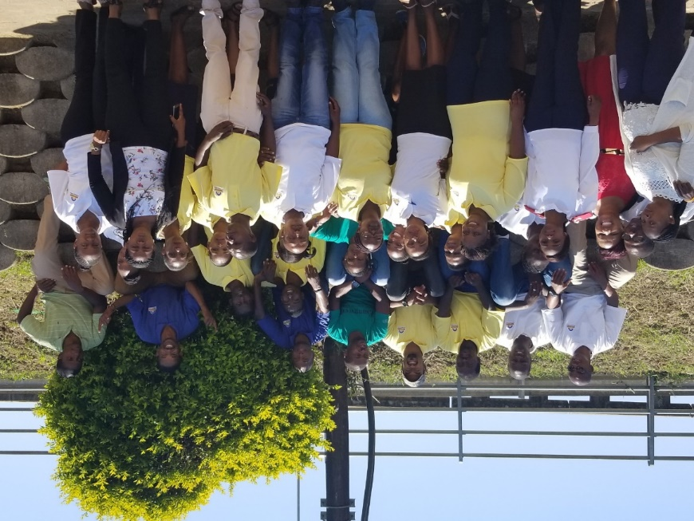
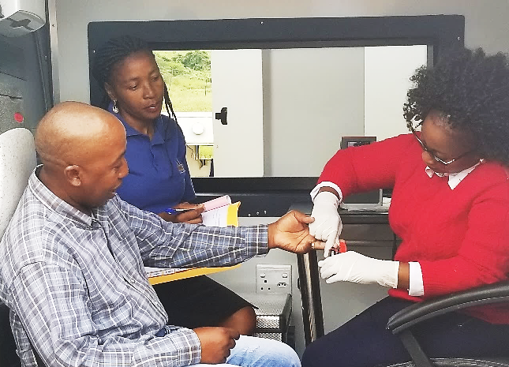
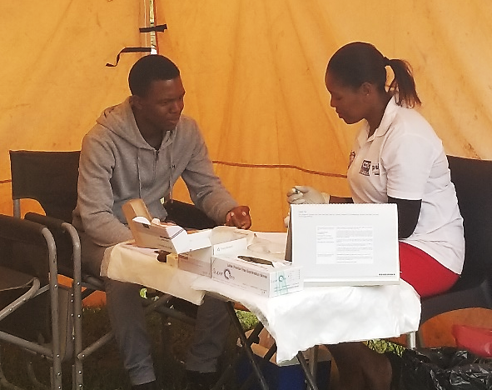
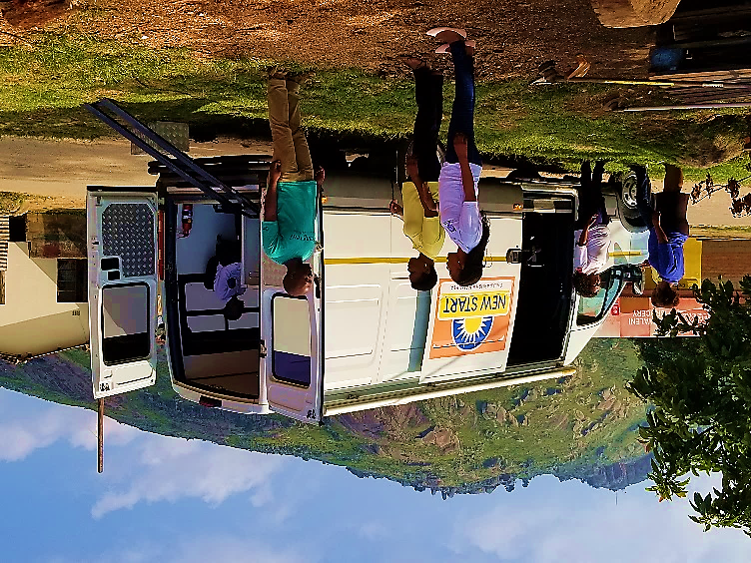
Acknowledgements
PSI’s dedicated staff of Expert Clients, HTS Counselors,
Drivers/Community Mobilizers, Nurses, and Management

